Slide 1
IEEE Internal Project Competition
Week 1 (Spring): Materials & Safety

Slide 2
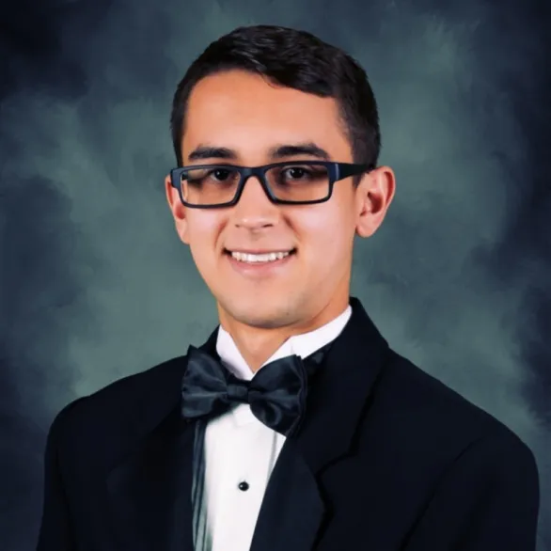
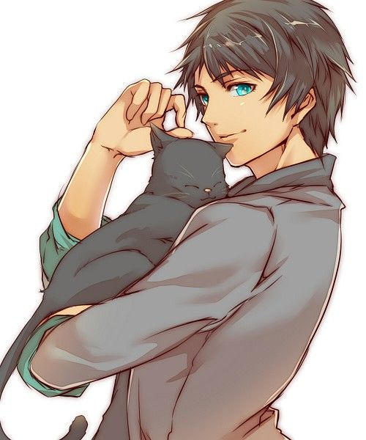
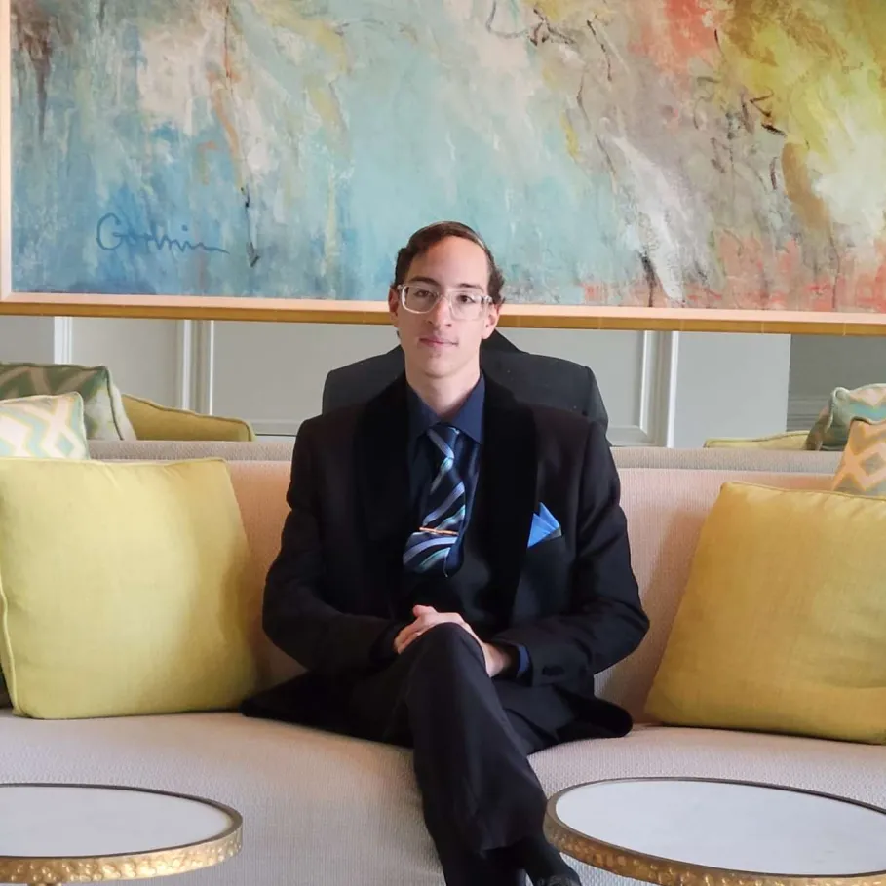
Meet the Team
Matias Guillen
Eren Siegman
Yousef Awad
Project Chair
Sophomore - Electrical Engineering
Internal Project Competition - Lead
Contact: vector8925
Project Committee
Sophomore - Computer Engineering
Internal Project Competition - Sub-Lead
Contact: eriks0527
Project Committee
Sophomore - Computer Engineering
Internal Project Competition - Sub-Lead
Contact: quil180

Slide 3
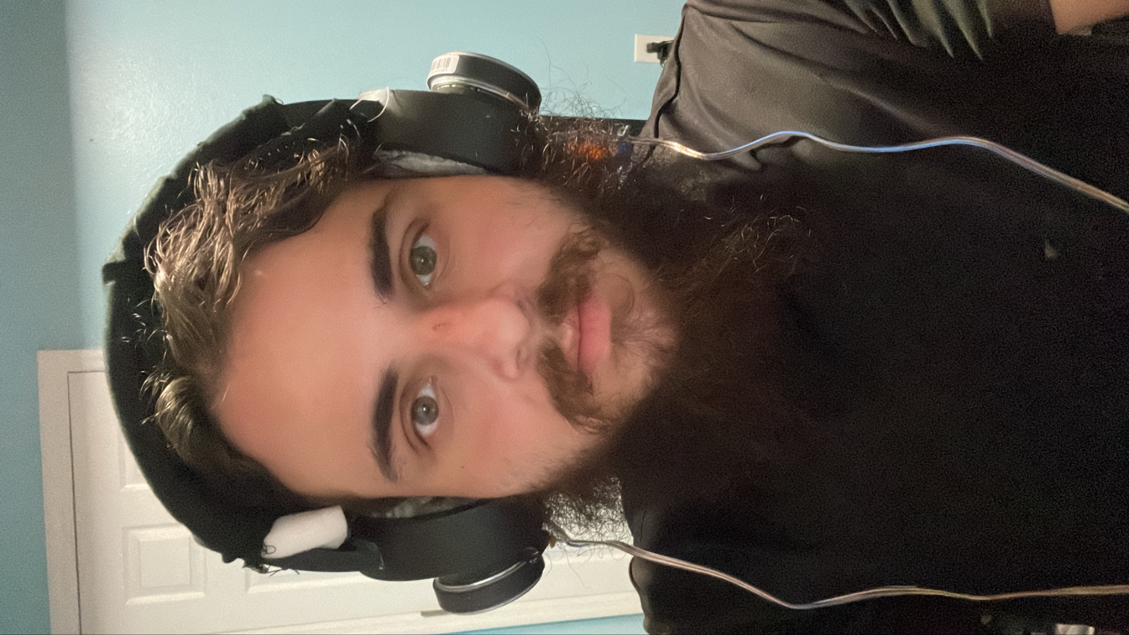
Meet the Team
Tino Hernandez
Project Committee
Sophomore - EE/CS/CPE/Delusion
Internal Project Competition - Sub-Lead
Contact: vjmuzik

Slide 4
Updates
We will distribute materials after this brief presentation.
Meetings will be Bi-Weekly now with main focus on technical assistance.
Workshop element to internal competition will be less frequent possible 1 maybe 2 other workshops in the entire semester [sorry I’m very busy :( ].
Due dates upcoming: Banquet (April 17th). Project deadline for submission of IEEE Awards is April 14th.
If you are new you are more than welcomed to join a group as long as they are okay with it!
If in any case materials were missed from the purchasing. You will have to cover with your own money.
And no, there will be no more second rounds of BOM submissions.

Slide 5
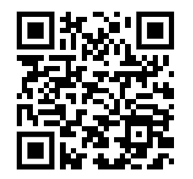
Attendance

Slide 6
Safety Website
Best Practices for Electronics Safety: A Comprehensive Guide

